Slide 1


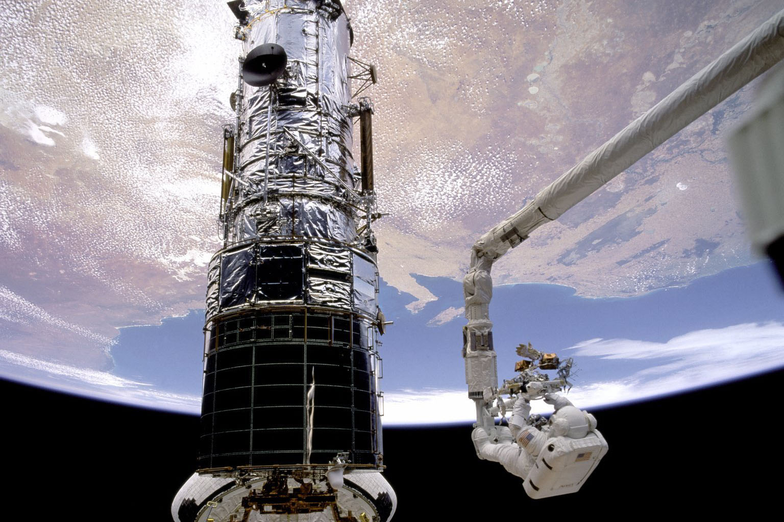
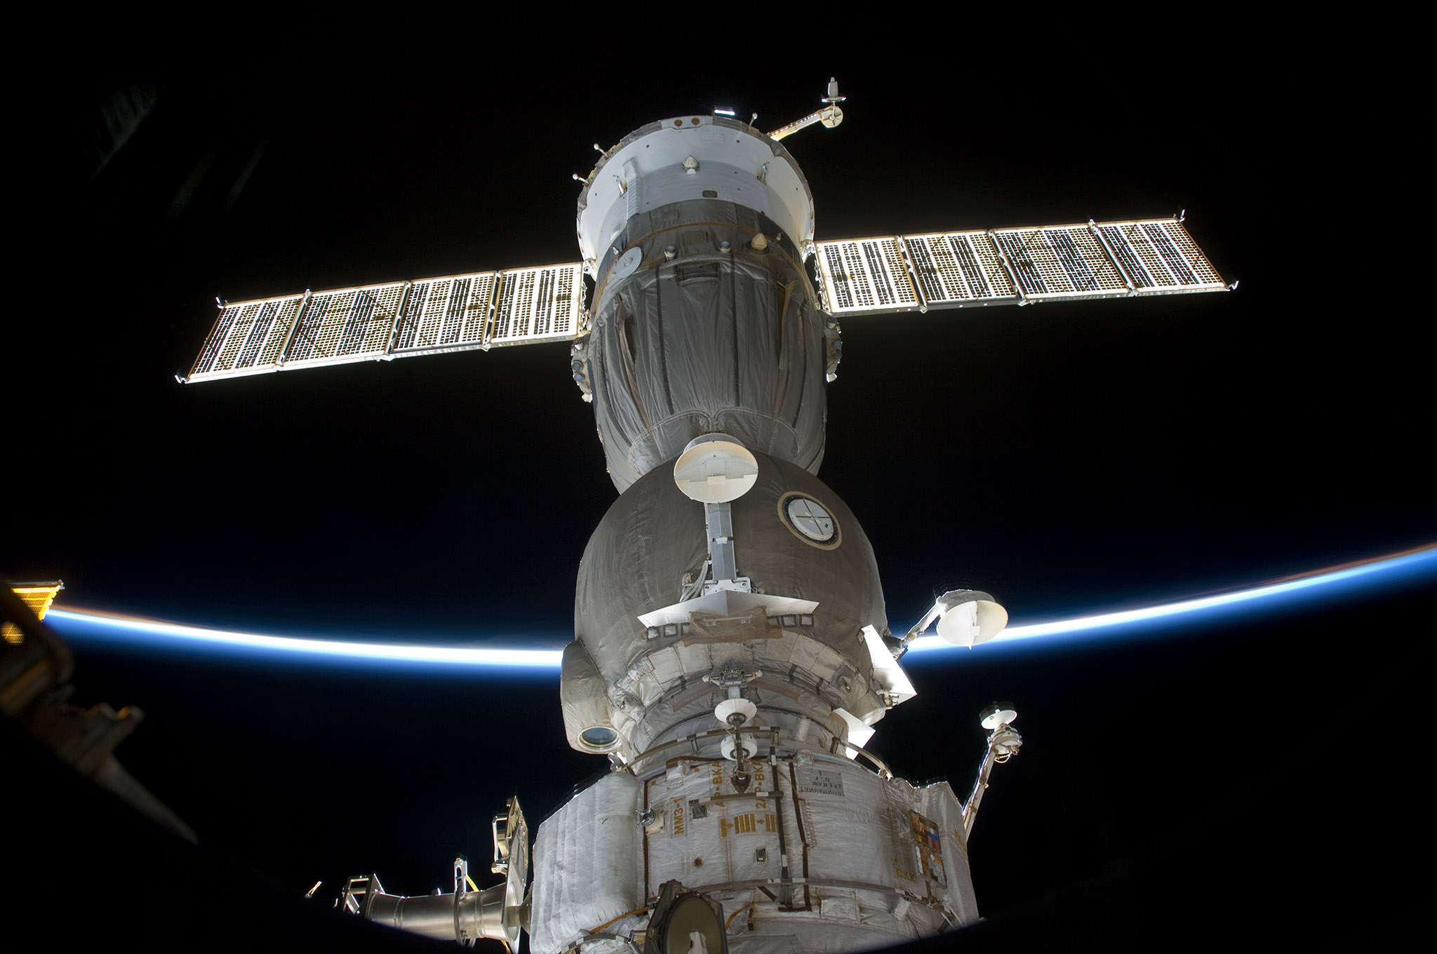
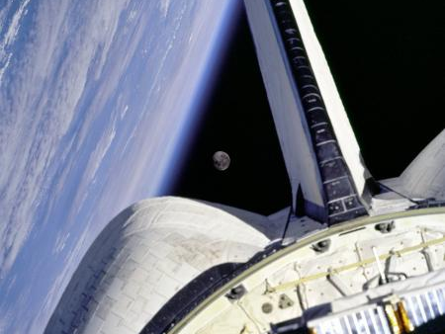
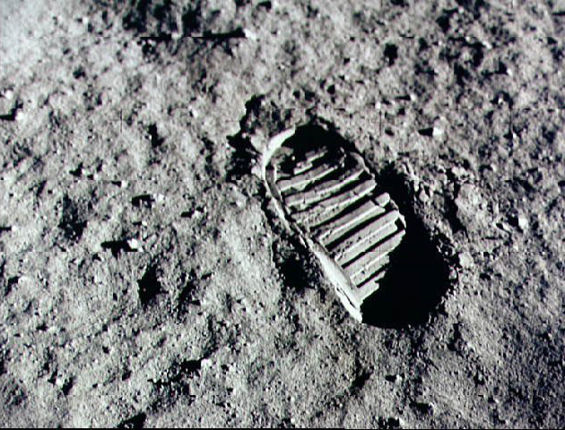
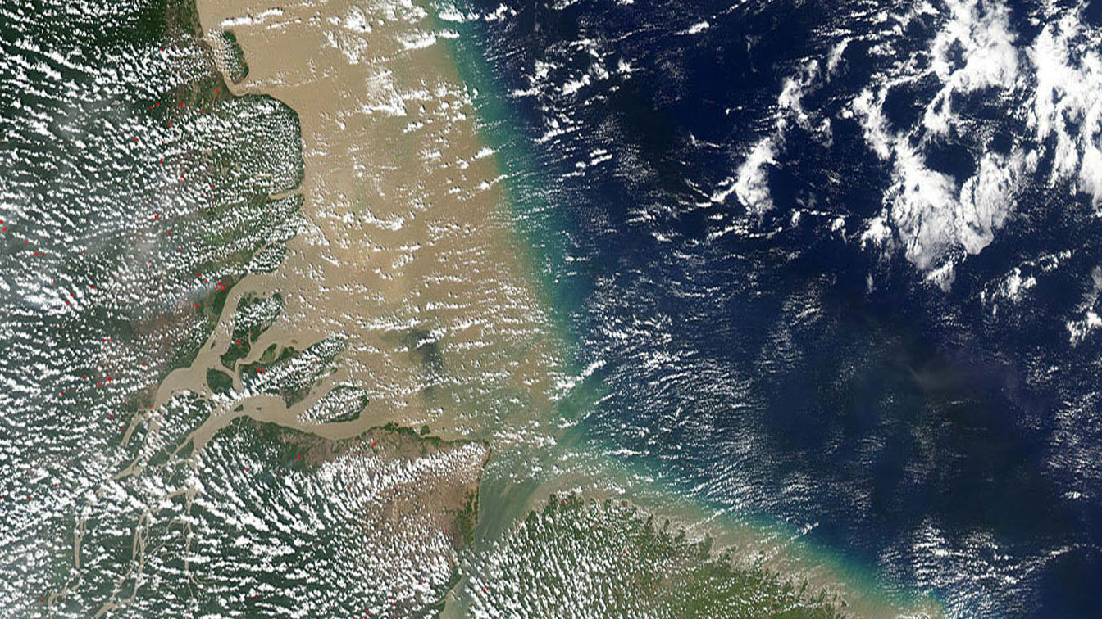
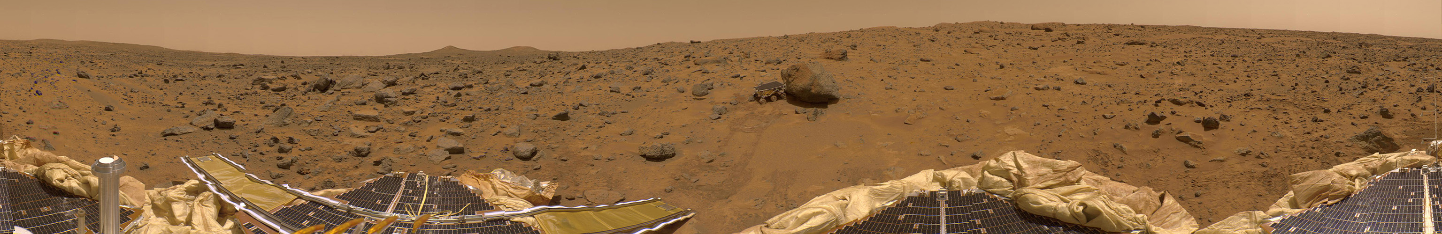
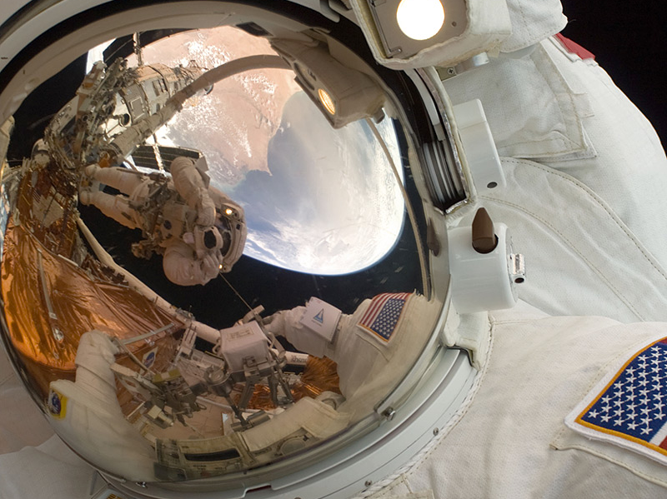


Slide 2
Create Dome Content Easily?

Slide 3
360° PowerPoint Presentations
The new PowerPoint Dome Tool makes it easy to create wrap-around presentations for a digital dome.
The template works with Microsoft PowerPoint, Google Docs, and LibreOffice.

Slide 4
Create Wide Format Slides in Minutes
Experience a Space Walk
View Earth From Orbit
Fly With the Cosmonauts

Slide 5
What does the tool do?
Drag and Drop Conversions
Prepare Wide Format Slides
Export 360°x90° Slides
The droplet utility allows end users to convert their slides into Domemaster formatted 1080p, 2k, or 4K images.
The PowerPoint Dome tool makes it easy for end users to prepare their own slides with a series of 14 pre-made dome compatible layouts.
The Dome template creates slides in a wide screen format that is compatible with all digital fulldome projections systems.

Slide 6
Present Immersive Panoramas

Slide 7
Display Slides

Slide 8
Dome Template Availability
The PowerPoint Dome template is the easiest way to create presentations for your dome.
You can download the template from AndrewHazelden.com

Slide 9
Thanks for Watching!

